Slide 1
CHAPTER 4 SOFTWARE PROJECT SCHEDULING

Slide 2

CHAPTER 4 SOFTWARE PROJECT SCHEDULING
Work Breakdown Structure, Organizational Chart, R.A.M,Histogram.
Critical Path Method
Project Evaluation and Review Technology, Gantt Chart
Agile Estimation Techniques
Agile Maturity Model

Slide 3
Project Scheduling
Scheduling is the process of deciding:
In what sequence a set of activities will be performed.
When they should start and be completed.
Tracking is the process of determining how well you are sticking to the cost estimate and schedule.

Slide 4
Some Basic Project Management Terminology
Deliverable: some concrete thing which is to be delivered, to the client or internally to the development team; e.g.
Specifications reports
Executable program
Source code
Task/Activity: something we have to do during the project; e.g.
Defining user requirements
Coding a module
Doing system testing
Each task or activity will take some length of time
Referred to as duration of task
Sometimes measured in days, weeks, etc.
Sometimes measured in person-days, person-weeks, etc.
Person-day = number of people X number of days
Example: 12 person days for writing all code could mean 1 person 12 days or 4 people 3 days
Note: not always true that a task that takes 1 programmer 12 days would take 12 programmers 1 day

Slide 5
Dependencies and Milestones
For a given task or activity, may be impossible to start it without some other task(s) or activity(ies) having been completed; e.g.
Cannot start coding without completing design
Cannot start system testing without completing code integration and test plan
If task B cannot start without A being completed, we say
B depends on A
There is a dependency between A and B
Milestone: some achievement which must be made during the project; e.g.
Delivering some deliverable
Completing some task
Note, delivering a deliverable may be a milestone, but not all milestones are associated with deliverables

Slide 6
Setting and Making Deadlines
Deadline time by which milestone has to be met
Some deadlines are set by the client
Others are set by us on project to make sure project stays on track
To set a deadline for completing task T, we must consider how long it will take to:
Complete the tasks that task T depends on
Complete task T itself
If we miss a deadline, we say (euphemistically) “the deadline has slipped”
This is virtually inevitable
Important tasks for project managers
Monitor whether past deadlines have slipped
Monitor whether future deadlines are going to slip
Allocate or reallocate resources to help make deadlines
PERT chart and Gantt charts help project managers do these things (among others)

Slide 7
The purpose of a WBS is to identify terminal elements
WBS serves as the basis for much of project planning.
If task is broken down into large number of activities, it should be distributed to large number of engineers

Slide 8
Work Breakdown Structure (WBS)
It is used to decompose a given task set into small activities
Root of the tree is labeled by the problem name
Each node is broken down into smaller activities
Again it is decomposed I into smaller activities until at the leaf level

Slide 9
The parameters to build WBS are
System Structure
Functions
Organizational Units
Life Cycle Phase

Slide 10
WBS Structure
WBS
Task 1
Task 2
Task 3
Activity - 1
Activity - 2
Process - 1
Process - 2
Process - 3

Slide 11
Purpose and Benefits of a WBS
It subdivides the program scope into smaller, manageable work efforts
An 'Owner' is established for each deliverable
Responsibility for each task can be established
Estimated costs/budgets can be established for each element
It provides a framework to identify programs separately from organizations, funding sources, accounting systems, etc.

Slide 12
WBS for MIS s/w
MIS Application
Requirement
Specification
Design
Code
Test
Document
Database
Part
GUI
Part
Database
Part
GUI Part

Slide 13
Scheduling -WBS
1.Planning & Analysis
1.1 Requirement Gathering
1.1.1 Creating Questionnaire
1.1.2 Observation method
2. Designing
2.1 GUI forms
2.2 Database design
3. Development
3.1 Coding module 1
3.2 Coding module 2
4. Testing
4.1 Unit Testing
4.2 Integration Testing
5. Deployment & Maintenance
Notes:
Reference: software engineering by Rajib Mall

Slide 14
 | Notation | Activity | Activity | Duration | Immediate
 |  |  |  | (days) | Predecessor
 | 1 | Obtain Requirements | Obtain Requirements | 4 | -
 | 2 | Analyze operations | Analyze operations | 4 | -
 | 3 | Define subsystems | Define subsystems | 2 | 1
 | 4 | Develop Database | Develop Database | 4 | 1
 | 5 | Make decision analysis | Make decision analysis | 3 | 2
 | 6 | Identify constraints | Identify constraints | 2 | 5
 | 7 | Build module1 | Build module1 | 8 | 3,4,6
 | 8 | Build module2 | Build module2 | 12 | 3,4,6
 | 9 | Build module3 | Build module3 | 18 | 3,4,6
 | 10 | Write report | Write report | 10 | 6
 | 11 | Integration and test | Integration and test | 8 | 7,8,9
 | 12 | Implementation | Implementation | 2 | 10,11
Show the Gantt Chart , PERT chart , Critical Path with the help of Tool

Slide 15
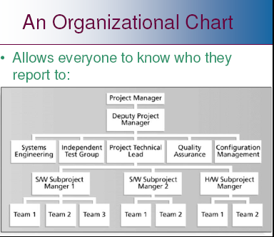

Slide 16
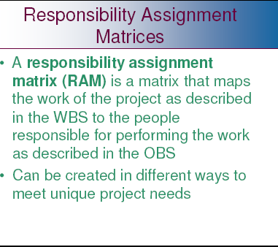

Slide 17
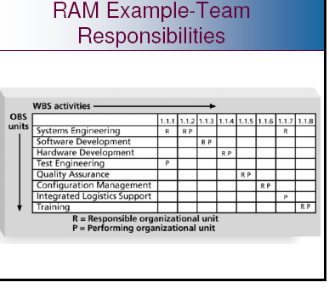

Slide 18
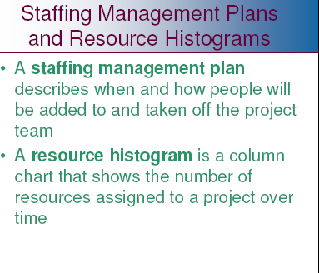

Slide 19
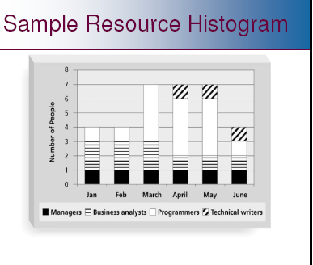

Slide 20
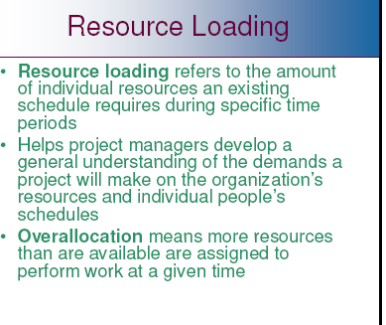

Slide 21
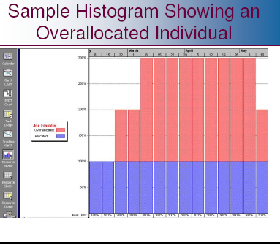

Slide 22
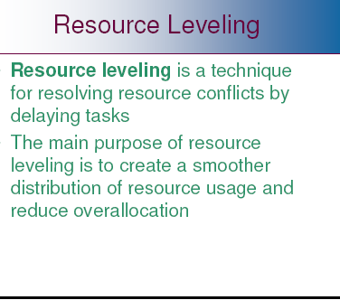

Slide 23
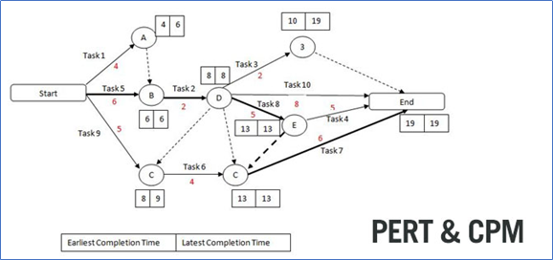

Slide 24
PERT Charts
PERT = Project Evaluation and Review Technique
PERT chart = graphical representation of the scheduling of events in a project
Sample PERT Chart:
A PERT chart is a graph
Edges are tasks/activities that need to be done
Nodes are the events or milestones
Task edge T from event node E1 to event node E2 signifies:
Until event E1 happens, task T cannot be started
Until task T finishes, event E2 cannot happen
Events often simply represent completion of tasks associated with arrows entering it
6
3
10
E
B
3
13
0
4
2
6
A
13
1
4
2
F
0
4
C
7
D
10
3
3
4
3
5
7
10

Slide 25
PERT Chart Task Edges
Parts of a task/activity edge
Task letter:
Often keyed to a legend to tell which task it represents
Task duration = how long (e.g. days, hours) task will take
Task letter
D
5
Task duration

Slide 26
PERT Chart Event Nodes
Event Number:
Sequence number assigned
Only task edges indicate dependencies
Earliest Completion Time (ECT):
Earliest time this event can be achieved, given durations and dependencies
9
5
19
Latest Completion Time (LCT):
Latest time that this event could be safely achieved

Slide 27
Building a PERT Chart
Steps:
Make a list of all project tasks (and events if possible).
Find interrelated task dependencies (what task has to be completed before other tasks)
Draw initial PERT without durations, ECTs or LCTs
Estimate duration of each task
Fill in durations
Calculate ECTs and LCTs
We will do this for an example system:
→ Generic software system with 3 modules

Slide 28
Example: Generic Software Project
TASK ID Task Description
A Specification
B High Level Design
C Detailed Design
D Code/Test Main module
E Code/Test DB module
F Code/Test UI module
G Write test plan
H Integrate/System Test
I Write User Manual
J Typeset User Manual
To start PERT chart: identify dependencies between tasks

Slide 29
Dummy Tasks
Sometimes it is necessary to use dummy tasks:
Shows the dependency between 2 events where no activity is performed
Example:
Events 3, 4 signify the compilation of separate modules.
Create an event 5 to signify “all modules compiled together”.
Denote dummy tasks using dash lines
9
3
10
T
9
5
12
3
9
4
12

Slide 30
Example: Tasks with Dependencies
To start the PERT, identify the dependencies amongst tasks
TASK ID Task Description Preceed ID Succ. ID
A Specification 1 2
B High Level Design 2 3
C Detailed Design 3 4
D Code/Test Main 4 5
E Code/Test DB 4 6
F Code/Test UI 4 7
G Write test plan 4 8
Dummy Task 5 8
Dummy Task 6 8
Dummy Task 7 8
H Integrate/System Test 8 9
I Write User Manual 8 10
J Typeset User Manual 10 9

Slide 31
Software Example: Skeleton PERT Chart
5
D
A
B
C
E
H
1
2
3
4
6
8
9
I
F
J
7
1
G
Note: dummy tasks connecting events 5, 6 and 7 to 8

Slide 32
Estimating Durations
Suggestions for estimating durations of tasks:
Don’t just make up a number
Look at previous similar tasks from other projects and use those as guidelines
Try to identify factors such as difficulty, skill level
Each weighting factor will help you make a better estimate
Factors to consider:
Difficulty of task
Size of team
Experience of team
Number, attitude and availability of end users
Management commitment
Other projects in progress

Slide 33
PERT Chart With Durations
5
D
7
A
B
C
E
H
1
2
3
4
6
8
5
9
3
2
2
6
F
I
J
2
1
3
7
1
G
2
Say we have estimated durations of all tasks (in days)
New PERT chart, with durations filled in:
Note, dummy tasks (dashed lines) always have a duration of zero
Notes:
Dummy tasks always have 0 duration.
From this, we can calculate ECTs and LCTs

Slide 34
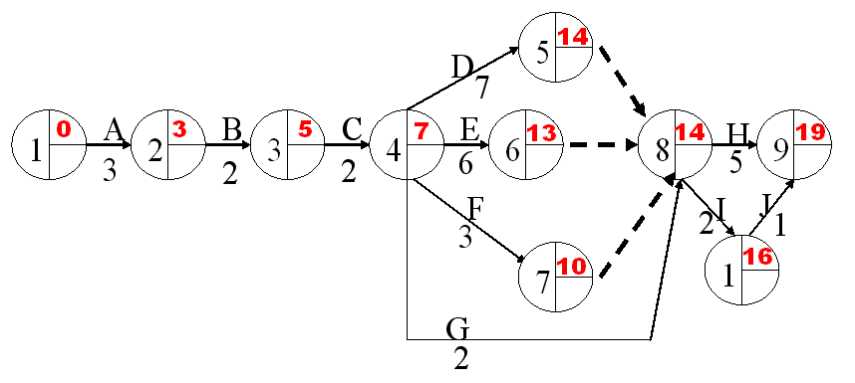
Calculating ECTs
ECT = earliest time event can be completed
To calculate:
For an event not depending on others: ECT = 0
Usually this is the first event
For an event E depending on one or more others:
Calculate ECTs of event(s) that E depends on
Add duration(s) of task(s) leading to E
If E depends on more than one event, take MAX
Proceed left to right ( → ) through the chart
Exercise: calculate the ECT for our example.

Slide 35
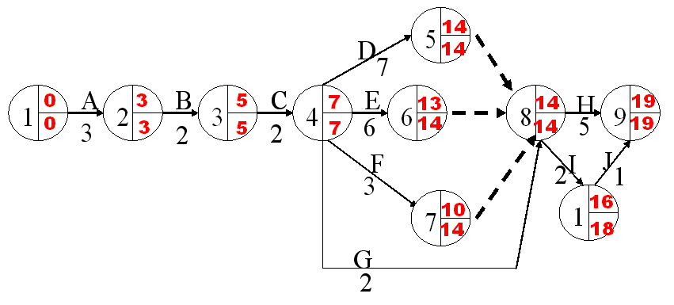
Calculating LCT
LCT = latest time event can be completed, while still finishing last ask at indicated time
To calculate:
For an event which no other events depend on: LCT = ECT
Generally there will only be one such event
For an event E which one or more others depend on:
Calculate LCTs of event(s) that depend on E
Subtract duration(s) of task(s) leading from E
If more than one event depends on E, take MINIMUM
Proceed right to left ( ← ) through PERT chart
Exercise: calculate LCT for our example

Slide 36
Critical Path
Red line is the critical path
What does it represent?

Slide 37
Uses of PERT Charts
We can use PERT charts for:
Determining the estimated time to complete a project
Deriving actual project dates
Allocating resources
Identifying potential and current problems (is one task behind schedule?, can we shuffle people?)
Critical Path: Path through chart such that if any deadline slips, the final deadline slips (where all events have ECT = LCT (usually there is only one)
In software example:
Task I is not on the critical path: even if we don’t finish it until time 18, we’re still okay
Task D is on the critical path: if we don’t finish it until for example, time 16, then:
We can’t start task H (duration 3) until time 16
So we can’t complete task H until time 21
We can use PERT charts for
Identifying the critical path
Reallocating resources, e.g. from non-critical to critical tasks.

Slide 38
Gantt Charts
Graphical Representation of a schedule
Helps to plan, coordinate and track specific tasks in a project
Named after Henry Gantt who invented them in 1917
Depicts some of the same information as on a PERT chart
Also depicts new information

Slide 39
Example Gantt Chart
TASKS
A Study current email system
B Define end-user requirements
C Design Class diagram
D Acquire computer technology
E Plan & code email modules
F Acceptance test new system
G Deliver new system
1 2 3 4 5 6 7 8 9 10 11 12
Today
Questions: From the above, can you guess:
Which, if any, tasks should have been completed by today and aren’t even started? ______
Which, if any, tasks have been completed? ______
Which, if any, tasks have been completed ahead of schedule:? ______
Which, if any, tasks are on or ahead of schedule? _________
Which, if any, tasks are behind schedule? ________

Slide 40
Building and Using a Gantt Chart
Steps for building a Gantt Chart
Identify the tasks to be scheduled
Determine the durations of each task
List each task down the vertical axis of chart
In general, list tasks to be performed first at the top and then move downward as the tasks will happen
Use horizontal axis for the dates
Determine start and finish dates for activities
Consider which tasks must be completed or partially completed before the next task
To use the Gantt chart to report progress:
If the task has been completed, completely shade in the bar corresponding to the task
If the task has been partially completed, shade in the percentage of the bar that represents the percentage of the task that has been completed
Unshaded bars represents tasks that have not been started.

Slide 41
PERT vs. Gantt
PERT chart
All us to show dependencies explicitly
Allow us to calculate critical path
Can tell us how one task falling behind affects other tasks
Gantt charts
Allow us to record progress of project
Allow us to see what tasks are falling behind
Allow us to represent overlapping tasks
Project Management Tools, e.g. MS Project
Allow us to specify tasks, dependencies, etc
Allow us to specify progress on tasks, etc
Can generate either PERT or Gantt charts (whichever we want) from data entered

Slide 42
 | Notation | Activity | Activity | Duration | Immediate
 |  |  |  | (days) | Predecessor
 | 1 | Obtain Requirements | Obtain Requirements | 4 | -
 | 2 | Analyze operations | Analyze operations | 4 | -
 | 3 | Define subsystems | Define subsystems | 2 | 1
 | 4 | Develop Database | Develop Database | 4 | 1
 | 5 | Make decision analysis | Make decision analysis | 3 | 2
 | 6 | Identify constraints | Identify constraints | 2 | 5
 | 7 | Build module1 | Build module1 | 8 | 3,4,6
 | 8 | Build module2 | Build module2 | 12 | 3,4,6
 | 9 | Build module3 | Build module3 | 18 | 3,4,6
 | 10 | Write report | Write report | 10 | 6
 | 11 | Integration and test | Integration and test | 8 | 7,8,9
 | 12 | Implementation | Implementation | 2 | 10,11
Show the Gantt Chart , PERT chart , Critical Path with the help of Tool

Slide 43
With the WBS information Calculate Critical Path ?
How to find the critical path in a project:
Step 1: Identify all tasks required to complete the project
Step 2: Determine the sequence of tasks
Step 3: Estimate the duration of each task
Step 4: Draw a network diagram
Step 5: Identify the critical path
Step 6: Calculate the float
Step 7: Monitor the critical path

Slide 44
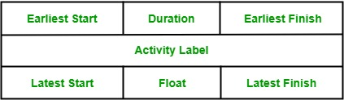
Activity label is the name of the activity represented by that node.
Earliest Start is the date or time at which the activity can be started at the earliest.
Earliest Finish is the date or time at which the activity can be completed at the earliest.
Latest Start is the date or time at which the activity can be started at the latest.
The latest Finish is the date or time at which the activity can be finished at the latest.
Float is equal to the difference between the earliest start and latest start or earliest finish and latest finish.

Slide 45
Activity | Duration (In weeks) | Predecessor
A | 6 | -
B | 4 | -
C | 3 | A
D | 4 | B
E | 3 | B
F | 10 | -
G H | 3 2 | E,F C,D

Slide 46
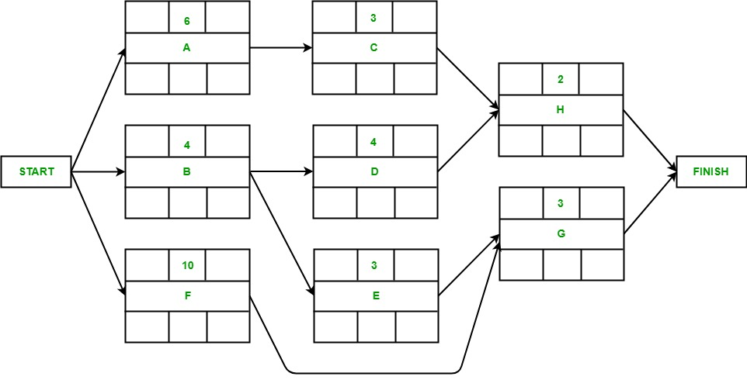

Slide 47
Activity A may start immediately. Hence, the earliest date for its start is zero i.e. ES(A) = 0. It takes 6 weeks to complete its execution. Hence, earliest it can finish is week 6 i.e. EF(A) = 6.
Activity B may start immediately. Hence, the earliest date for its start is zero i.e. ES(B) = 0. It takes 4 weeks to complete its execution. Hence, the earliest it can finish is week 4 i.e. EF(B) = 4.
Activity F may start immediately. Hence, the earliest date for its start is zero i.e. ES(F) = 0. It takes 10 weeks to complete its execution. Hence, the earliest it can finish is week 10 i.e. EF(F) = 10.
Activity C starts as soon as Activity A completes its execution. Hence, the earliest week it can start its execution is week 6 i.e. ES(C) = 6. It takes 3 weeks to complete its execution. Hence, the earliest it can finish is week 9 i.e. EF(C) = 9.
Activity D starts as soon as Activity B completes its execution. Hence, the earliest week it can start its execution is week 4 i.e. ES(D) = 4. It takes 4 weeks to complete its execution. Hence, the earliest it can finish is week 8 i.e. EF(D) = 8.
Activity E starts as soon as Activity B completes its execution. Hence, the earliest week it can start its execution is week 4 i.e. ES(E) = 4. It takes 3 weeks to complete its execution. Hence, the earliest it can finish is week 7 i.e. EF(E) = 7.
Activity G starts as soon as activity E and activity F completes their execution. Since the activity requires the completion of both for starting its execution, we would consider the MAX(ES(E), ES(F)). Hence, the earliest week it can start its execution is week 10 i.e. ES(G) = 10. It takes 3 weeks to complete its execution. Hence, the earliest it can finish is week 13 i.e. EF(G) = 13.
Activity H starts as soon as activity C and activity D completes their execution. Since the activity requires the completion of both for starting its execution, we would consider the MAX(ES(C), ES(D)). Hence, the earliest week it can start its execution is week 9 i.e. ES(H) = 9. It takes 2 weeks to complete its execution. Hence, the earliest it can finish is week 11 i.e. EF(H) = 11.

Slide 48
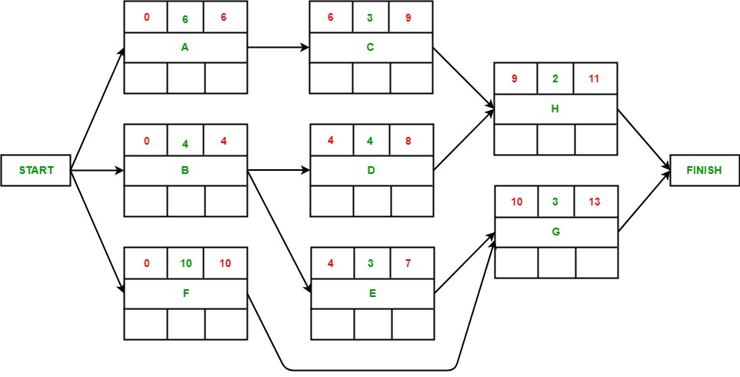

Slide 49
Activity G’s latest finish date is equal to the earliest finish date of the precedent activity of finish according to the assumption i.e. LF(G) = 13. It takes 3 weeks to complete its execution. Hence, the latest it can start is week 10 i.e. LS(G) = 10.
Activity H’s latest finish date is equal to the earliest finish date of the precedent activity of finish according to the assumption i.e. LF(H) = 13. It takes 2 weeks to complete its execution. Hence, the latest it can start is week 11 i.e. LS(H) = 11.
The latest end date for activity C would be the latest start date of H i.e. LF(C) = 11. It takes 3 weeks to complete its execution. Hence, the latest it can start is week 8 i.e. LS(C) = 8.
The latest end date for activity D would be the latest start date of H i.e. LF(D) = 11. It takes 4 weeks to complete its execution. Hence, the latest it can start is week 7 i.e. LS(D) = 7.
The latest end date for activity E would be the latest start date of G i.e. LF(G) = 10. It takes 3 weeks to complete its execution. Hence, the latest it can start is week 7 i.e. LS(E) = 7.
The latest end date for activity F would be the latest start date of G i.e. LF(G) = 10. It takes 10 weeks to complete its execution. Hence, the latest it can start is week 0 i.e. LS(F) = 0.
The latest end date for activity A would be the latest start date of C i.e. LF(A) = 8. It takes 6 weeks to complete its execution. Hence, the latest it can start is week 2 i.e. LS(A) = 2.
The latest end date for activity B would be the earliest of the latest start date of D and E i.e. LF(B) = 7. It takes 4 weeks to complete its execution. Hence, the latest it can start is week 3 i.e. LS(B) = 3.

Slide 50
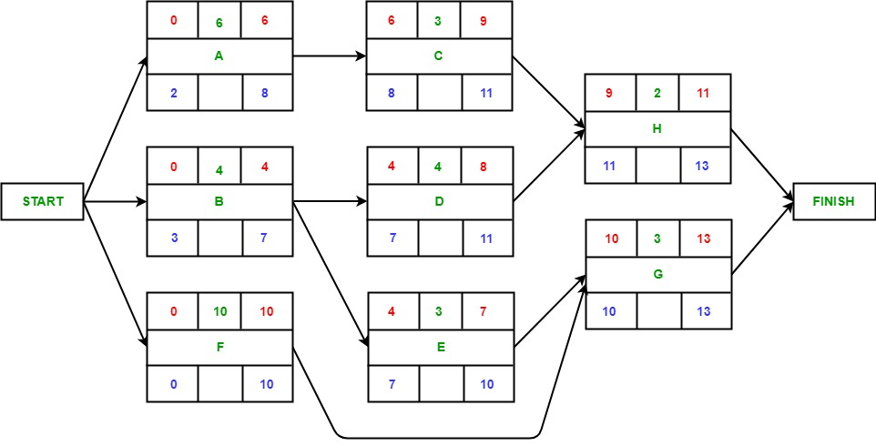

Slide 51
